Slide 1
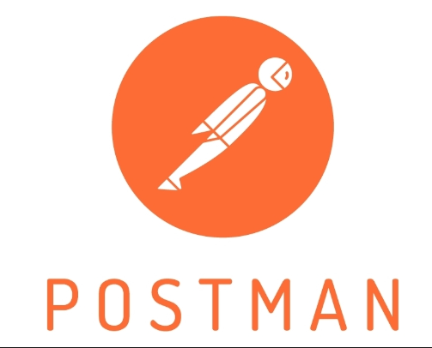
API Test Automation with Postman
İhsan Efe Uzun
19070006002

Slide 2
Overview
The importance of API testing
What is Postman?
Why should we use Postman?
Project sample

Slide 3
The importance of API testing
The purpose of API testing is to improve the code written in terms of improving the quality and to produce a better product or application.
API testing allows us to easily verify the response and data we want.
API tests can be managed in a controlled way.
When API tests fail, it is very useful for improving quality because error detection can be performed in a short time.
UI tests can take a long time in terms of user activities. However, API tests are being completed shortly. In this way, more errors can be found and edited in a shorter time.

Slide 4

API Testing Tools

Slide 5
What is Postman?
It officially defines itself as:
Postman is an API platform for building and using APIs. Postman simplifies each step of the API lifecycle and streamlines collaboration so you can create better APIs—faster.
Postman can store and manage API specifications, documentation, workflow recipes, test cases and results, metrics, and everything else related to APIs.

Slide 6
Why should we use Postman?
1. API Client feature lets you send REST, SOAP, and GraphQL requests directly quickly within Postman.
2. Ensures safe automation and integration of manual tests that guarantee no code breaks.
3. Enables you to design and mock the responses of an API without having to set up a backend server.
4. Machine-readable documentation.
5. Monitor the API performance and response times at regular intervals.
6. The built-in version control lets you share and collaborate in real-time.
7. It is easy to use tool with a Graphical user interface and can be accessed easily after logging into your Postman account.

Slide 7
5 Factors to use Postman for API testing
1. Automate Testing : Postman lets you automate API testing and integrate it into your CI/CD pipeline. With the help of the Newman tool or Collection Runner Postman can be used to execute tests in iteration.
2. Platform and OS Compatibility : The Postman app is available on macOS, Windows, Linux, and Chrome.
3. Test maintenance : Using collection, Test maintenance becomes easy in Postman.
4. Technical support: Community support is everything that a developer basically expects from an ideal API testing tool. Postman holds strong support and community to enhance its usage in various platforms such as Github, Stackoverflow, and social media platforms.
5. Pricing : Being open-source, Postman is free of cost. You can get all of the above benefits for free. There are also paid plans for Postman Pro and Postman Enterprise to suit small to large enterprises

Slide 8
Challenges
Advanced features like multiple integrations, advanced reporting, and analytics are covered under the pricing model.
In the Postman tool, we do not have the option of reusing pre-written scripts.
Postman does not have a comprehensive documentation or support for advanced features or complex scenarios. Thus, you may need to do some research or experimentation to find the best practices

Slide 9
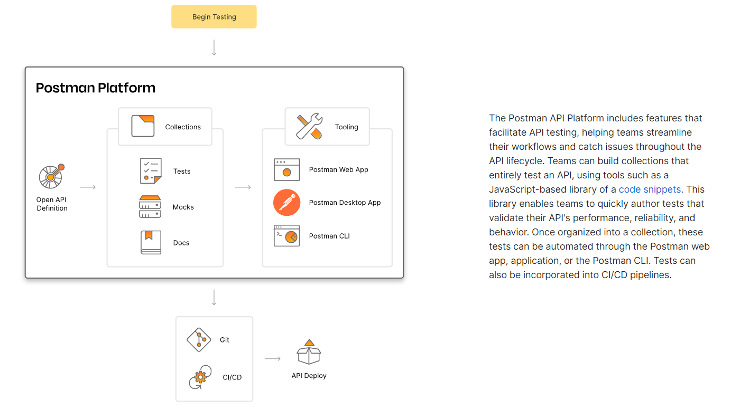

Slide 10
Resources
https://www.postman.com/solutions/api-test-automation/
https://medium.com/@mganapathi/top-6-reasons-to-choose-postman-for-api-testing-e8ae15d0a7d1
https://www.testrigtechnologies.com/blogs/api-testing-postman-vs-rest-assured-advantages-and-challenges/#:~:text=Advantages%20of%20the%20Postman%20Tool%3A&text=Using%20collection%2C%20Test%20maintenance%20becomes,with%20the%20CI%2FCD%20pipeline
Github link: https://github.com/ihsanefeuzun/SE-4458-Assignment

